Slide 1
Interactive Data Emerging Media & Technology
Final Project
Professor : David Silva
By – Gaurav Kudeshia

Slide 2
Analyzing Sales Data for Business Insights
Purpose:
This project aims to extract meaningful insights from sales data and establish objectives for project advancement. Utilizing the "US Superstores" dataset sourced from Kaggle ( https://www.kaggle.com/datasets/rohitsahoo/sales-forecasting ), spanning online sales between 2015 and 2019, it endeavors to uncover trends, patterns, and opportunities to enhance business efficacy.
The dataset offers comprehensive insights into online sales trends, customer demographics, and product performance, serving as a pivotal resource for strategic planning and informed decision-making.
The total online super store sales is 2,252,607.41 $ from 2015 to 2019.

Slide 3
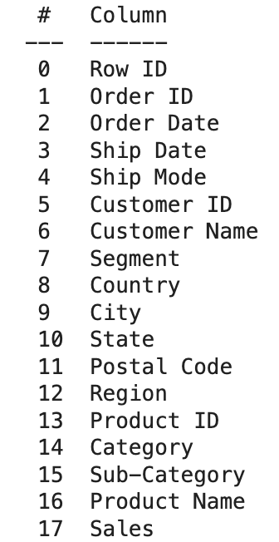
Exploring the dataset
The dataset comprises 17 columns, each delineating various attributes such as Row ID, Order ID, and Order Date, among others.

Slide 4
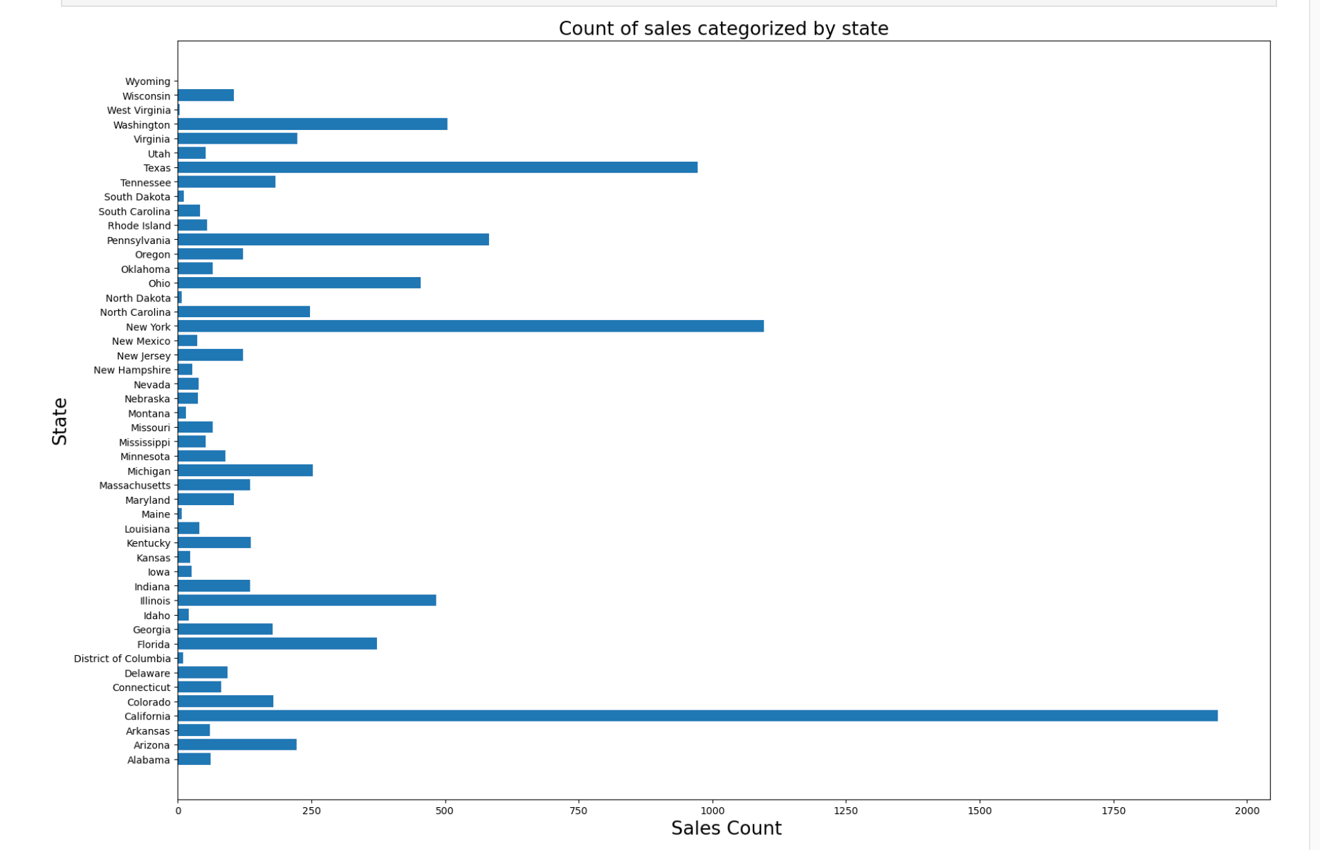
Where were the highest sales recorded ?
Online superstore sales in California are likely highest due to its dense population, tech-savvy residents, strong economy, advanced e-commerce infrastructure, and cultural factors. These elements create a conducive environment for online shopping, driving higher sales compared to other regions in the United States.

Slide 5
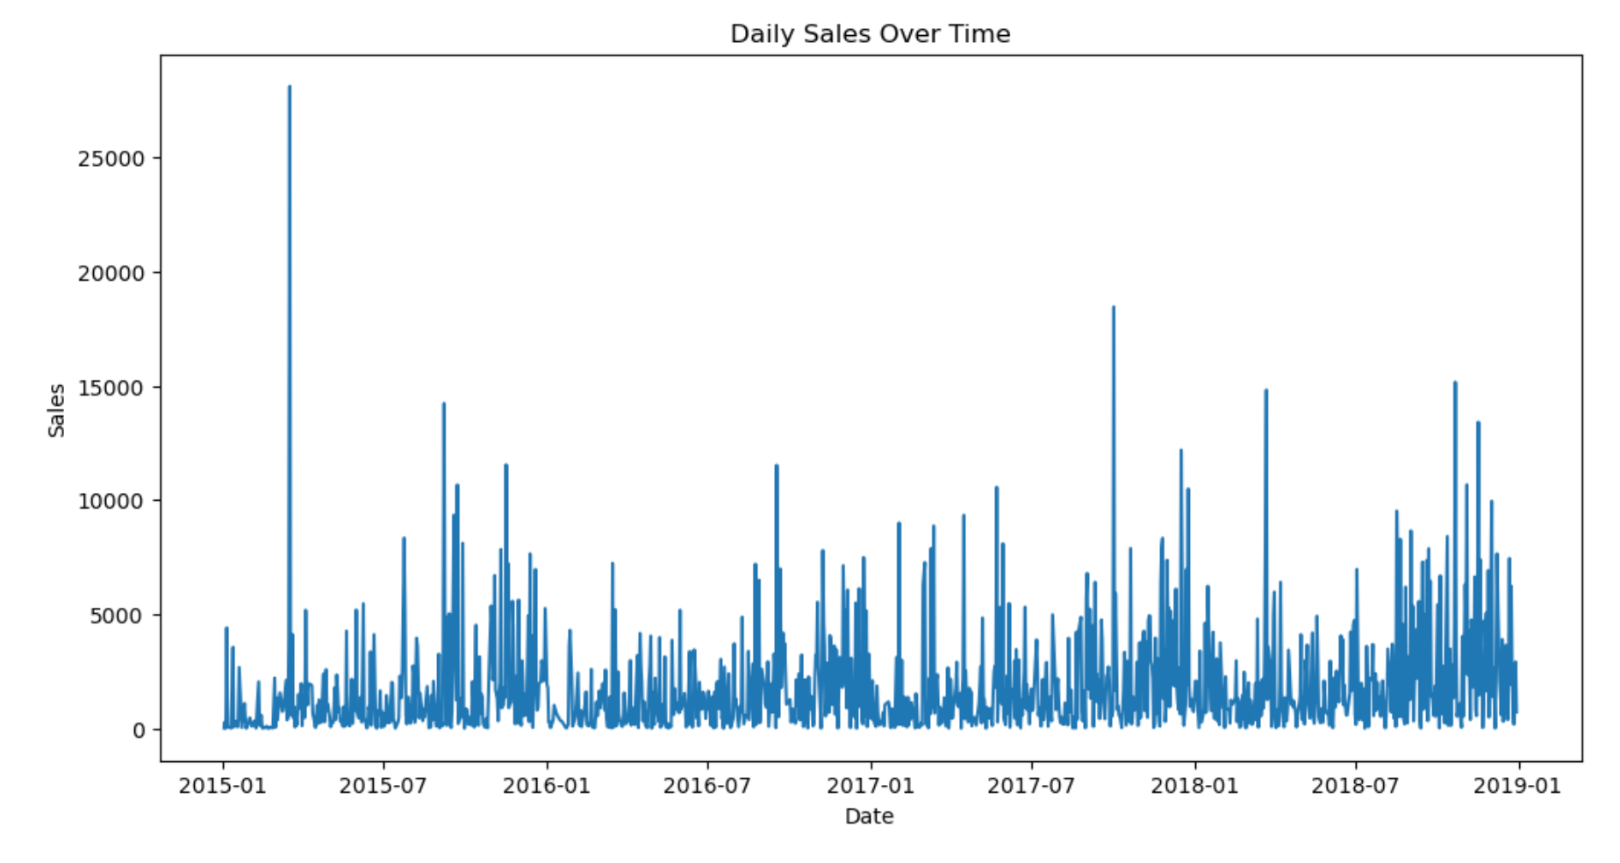
On which date customer bought most ?
It can be observed that sales during the months after July are consistently the highest in every year from 2015 to 2019. This trend can be attributed to various factors, including festive occasions like Christmas and New Year, as well as sales events such as Black Friday.

Slide 6
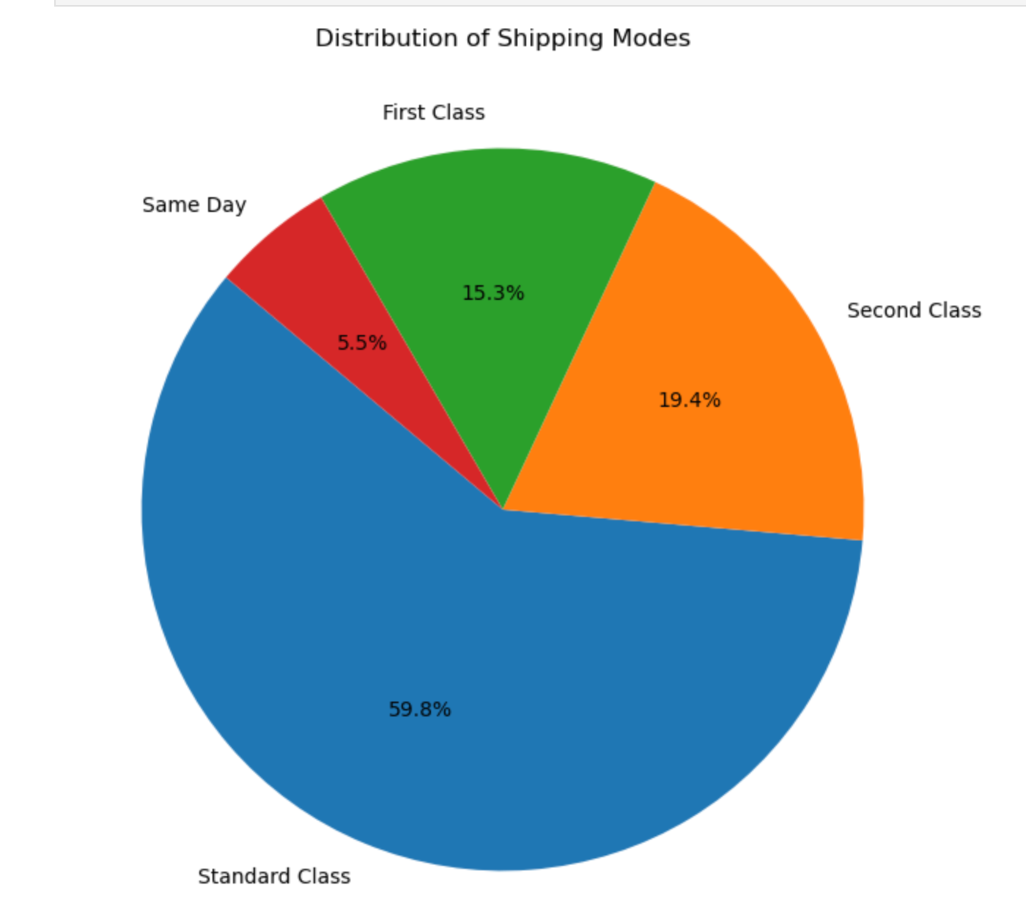
Which is the most used shipping class?
The pie chart reveals a 59.8% preference for the Standard class, indicating its popularity among consumers. Understanding its appealing traits can inform tailored marketing strategies and product improvements, offering insights into consumer preferences and habits.

Slide 7
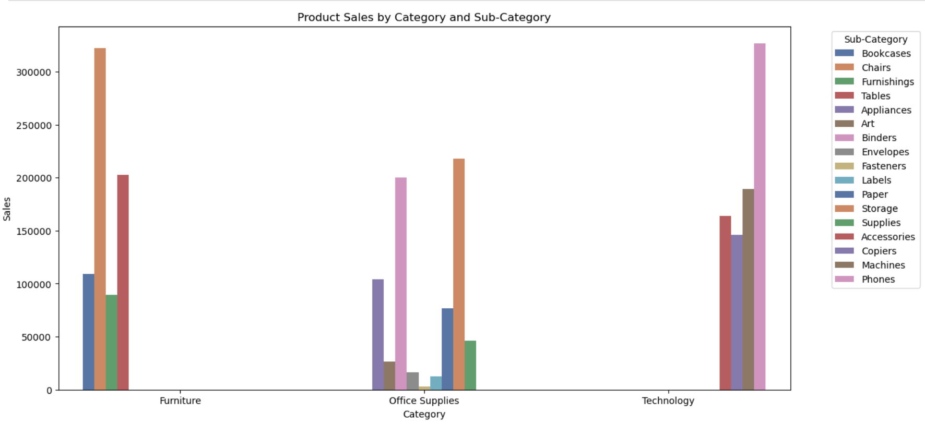
Considering these visualization, which displays product sales broken down by category and sub-category, how might a business use this information to optimize its inventory management and marketing strategies?

Slide 8
Conclusion
With over 60% of customers choosing standard shipping, there's a potential strategy to migrate these users to premium options like first-class or same-day delivery. We could implement a subscription model akin to Amazon Prime to encourage this shift, adding value for the customers while increasing revenue.
Noteworthy is Sean Miller's record purchase of $22,638.48, highlighting the appeal of high-end technology items, specifically videoconferencing systems. Personalized offers and exclusive incentives in this segment could enhance loyalty and encourage repeat business.
The sales data also indicates a robust market for phones and chairs. Initiating a rental program or introducing a certified refurbished section could attract a broader customer base, tapping into the growing interest in sustainable and cost-effective solutions.
Targeting more customers in California can be achieved by tailoring marketing efforts to local demographics, utilizing digital advertising on popular platforms, forming partnerships with local entities, offering incentives, and engaging with communities through events.

Slide 9

Thank you

